Slide 1


Social Buzz Performance Analysis

Slide 2


Today's agenda
Project recap
Problem
The Analytics team
Process
Insights
Summary

Slide 3

Social Buzz is a fast growing technology unicorn that need to adapt quickly to it’s global scale.
Accenture has begun a 3 month POC focusing on these tasks:
An audit of Social Buzz’s big data practice
Recommendations for a successful IPO
Analysis to find Social Buzz’s top 5 most popular categories of content
Project Recap

Slide 4

Problem
Over 100000 posts per day
36,500,000 pieces of content per year!
But how to capitalize on it when there is so much?
Analysis to find Social Buzz’s top 5 most popular categories of content

Slide 5



Andrew Fleming
Chief Technical Architect
The Analytics team
Marcus Rompton
Senior Principle
Eseosa Iyobosa
Data Analyst

Slide 6
Process
1
Data Understanding
2
Data Cleaning
3
Data Modelling
4
Data Analysis
5
Uncover Insight

Slide 7

Insights
Unique Categories: The dataset reveals a diverse range of content themes.
Most Popular Category: One category stands out with the highest engagement.
Peak Month: A specific month recorded the most posts, indicating peak activity.

Slide 8
Unique Categories and Most Popular Category
From the chart, there are 16 unique categories (each bar represents a category).
The most popular category is the one with the highest total score:
From the chart, Animals seems to have the highest bar, with a total score around 75,000 reactions.

Slide 9
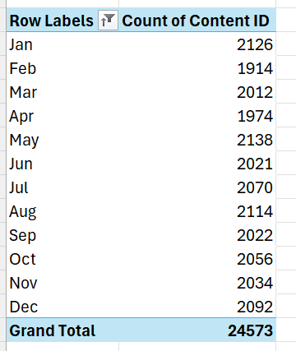
Peak Month
May had the highest number of posts, with 2,138 posts, indicating a peak in content creation.
May's peak posting period presents an opportunity to optimize future content strategies during high engagement months.

Slide 10

Unique Categories: The dataset includes a diverse range of 16 unique categories.
Most Popular Category: The category with the highest engagement is Animals, with approximately 75,000 reactions.
Summary
Month with the Most Posts: May recorded the highest content activity, with 2,138 posts.

Slide 11

Thank you!
ANY QUESTIONS?

